Slide 1
Kluwer Law Online Platform: Journals, IEL’s & Manuals
Holamatu Komeh

Slide 2
Introduction
Kluwer Law Online (KLO) is our flagship database covering all key aspects of international law.
It contains.
32 Journals (Incl. Archive)
25 International Encyclopaedia of Law Series (IEL)
9 Manuals
All articles and chapters are available as PDFs.
Authored by highly respected academics and practitioners across the globe to provide authoritative and forward-thinking content and analysis about the latest developments in international, regional, and national legislation, regulation, and case law in 11 practice areas.
KLO is an established information hub for the legal community, delivering an easy and intuitive user-experience.
Comprehensive offering for comparative research.

Slide 3
Highlights
An authoritative collection of high-quality publications focused on key aspects of international law
Topical articles, current developments and commentary authored by leading professors and specialist practitioners in their respective fields
Alerts—RSS and electronic table of content (ETOC)—inform you when new content is available online.
Clear overview of articles per Journal Issue and free abstracts of every article published allows for efficient research.
Journals include archives enabling you to search back to the original launch date in many cases.
Advanced searches can be used across ALL titles or your own selection.
Citation search option is available to directly go to the correct article

Slide 4
Discoverability
Features
MARC Records, freely available online for subscribers
Search via Google leads users to KLO (i.e. full text to be indexed instead of just metadata; SEO-optimized design; first page of every PDF rendered in HTML)
Connection with Google Scholar (inc. Subscriber Links)
Benefits
Easy search, better and more relevant results
Increased usage

Slide 5
Search Within Kluwer Law Online
Features
Easy to search within one or more publications
Search for words in title
Organize your search by date
Boolean operators with explanation
Search within all content, not only in meta data –full text search
Benefits
User-friendly search
Better and more relevant results within KLO

Slide 6
Browse
Features
Clear organization of manuals and loose-leafs
Abstracts of individual issues viewable on single screen
Journal articles and manual chapters are available in PDFs that exactly duplicate print pages
Easy to download, save, share, copy, and paste
Custom to your institution whereby only your subscriptions are organized and displayed prominently
Benefits
Structured product overview
Improved accessibility

Slide 7
Speed & Security
Features
Improved speed & security with migration to cloud
HTTPS security, including SFTP data transfer for metadata/PDF delivery subscriptions
Disaster recovery planning
GDPR data security
Benefits
Faster content load, including responsive design
Faster deployment of site enhancements

Slide 8
Overcoming Objections
Citations won’t follow everyone’s preferred system
This is impossible as all different countries and even different universities follow different citation rules. Citation information can be exported to RIS so it can be loaded in citation system
Up-to-dateness of IELs and other manuals is not always great
IELs should mainly used as a starting point of research, not for all the latest small updates. The main description of the systems should still be accurate. And it’s a continuing focus point for us.

Slide 9
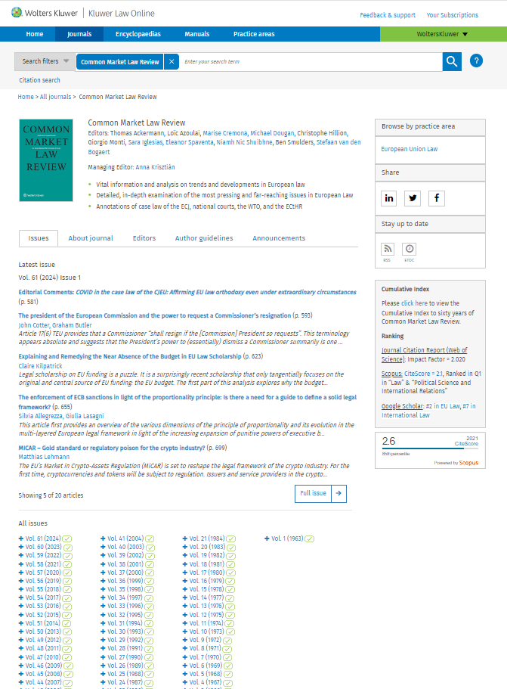
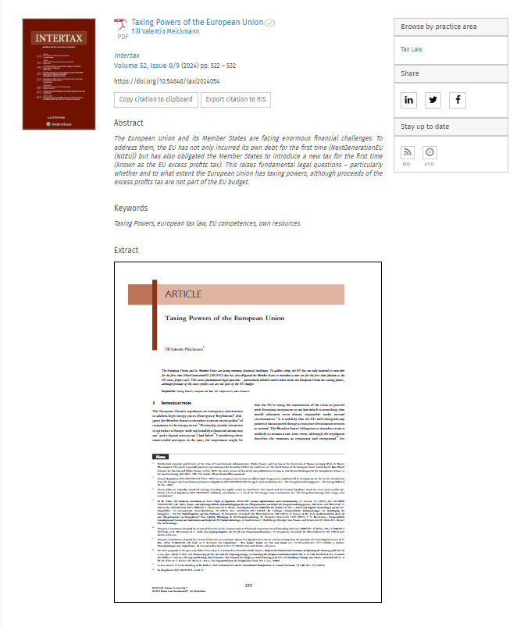
Kluwer Law Journals
Kluwer Law Online publishes a high-quality collection of peer-reviewed journals on international legal matters in many different practice areas, written by experts from around the world.
List of Law Journals
Commercial Arbitration | Arbitration: The International Journal of Arbitration, Mediation and Dispute Management
 | The Resolver: The Quarterly Magazine of The Chartered Institute of Arbitrators
 | ASA Bulletin
 | Asian Dispute Review
 | Asian International Arbitration Journal
 | b-Arbitra | Belgian Review of Arbitration
 | BCDR International Review
 | Dispute Resolution Journal
 | European Investment Law and Arbitration Review
 | Iurgium [Previously Spain Arbitration Review]
 | Journal of International Arbitration
 | Revista Brasileira de Arbitragem
 | Revue de l’arbitrage
 | World Trade and Arbitration Materials
Competition and Antitrust Law | World Competition
Corporate and Commercial Law | Business Law Review
 | European Company Law
 | European Business Law Review
 | Journal of European Consumer and Market Law
Energy and Environmental Law | European Energy and Environmental Law Review
European Union Law | Common Market Law Review
 | European Foreign Affairs Review
 | European Public Law
 | European Review of Private Law
 | Legal Issues of Economic Integration
Intellectual Property Law | Global Privacy Law Review
International Tax Law | Intertax
 | EC Tax Review
International Trade Law | Global Trade and Customs Journal
 | Journal of World Trade
Labour Law | International Journal of Comparative Labour Law and Industrial Relations
Transportation Law | Air & Space Law

